Slide 1
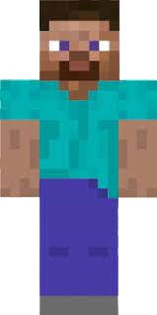
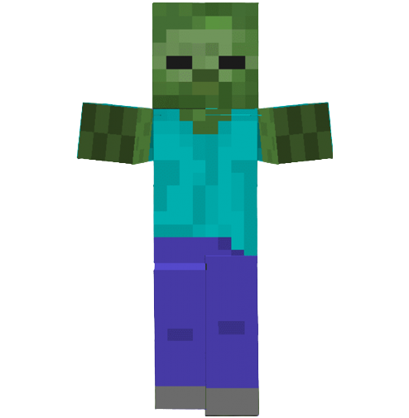
Train a Reinforcement Learning Agent in Minecraft to Fight Zombies!
Zehao Li
5/2/2023

Slide 2

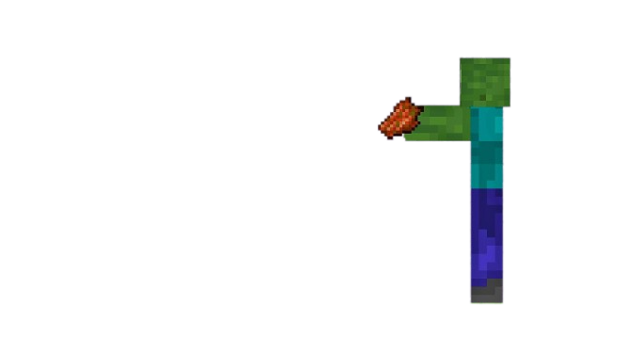

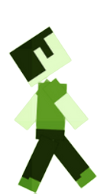

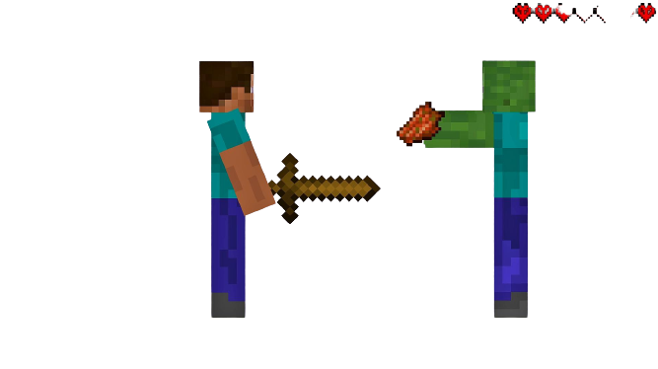
Motivation
Engaging and challenging problem
Demonstrate the capabilities of Reinforcement Learning (RL)
Potential applications in gaming and AI research
Improve AI behavior in gaming experiences

Slide 3
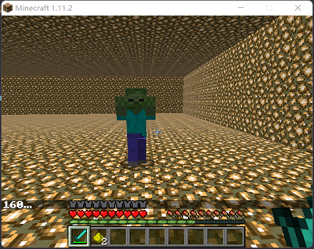
Problem Description
Minecraft: popular sandbox video game
Zombies: common in-game enemy
Goal: Train RL agent to fight zombies
State
Actions
Rewards
Transition
Move Forward
Move Backward
Turn Left
Turn Right
Attack
Agent transitions between states
Chosen action influences the next state
Experience: state, action, reward, next state, done
Stored in memory for learning
Zombie Damage | +100 reward
Zombie Killed | +500 reward
Time Alive | -0.1 reward for every time step
Damage Taken | -0.3 reward for damage taken

Slide 4

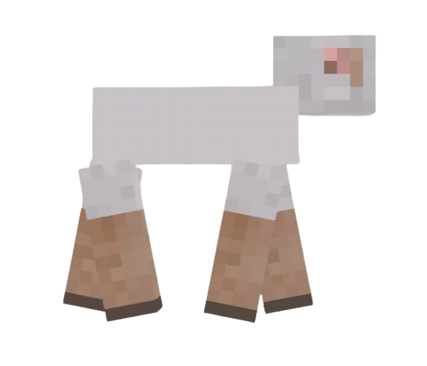
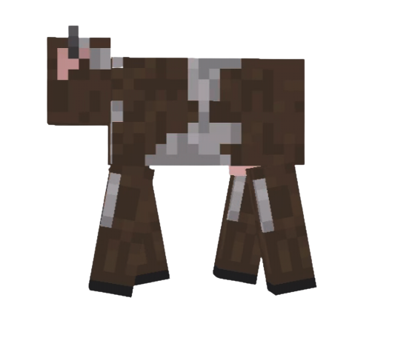
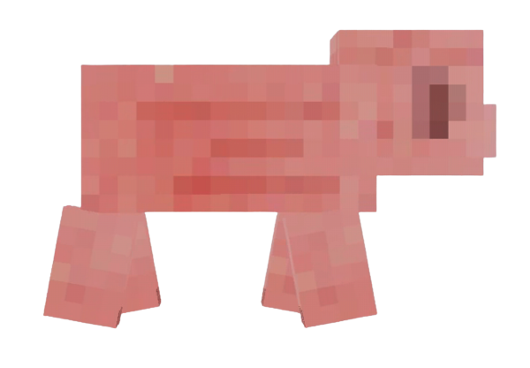
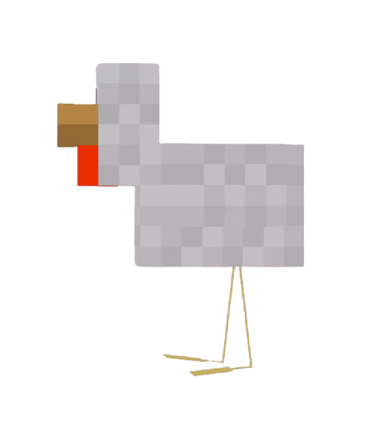
Key Insights and Approach
Deep Q-Network (DQN) for value function approximation
Experience Replay for efficient learning
Exploration vs Exploitation (Epsilon-greedy strategy)
Reward shaping for better performance

Slide 5
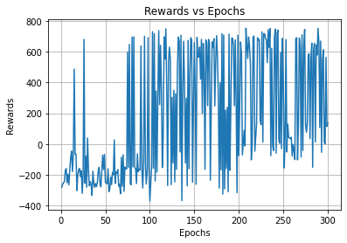
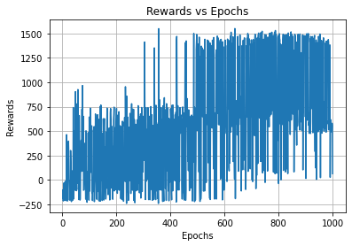
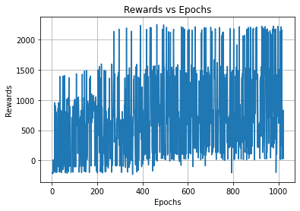
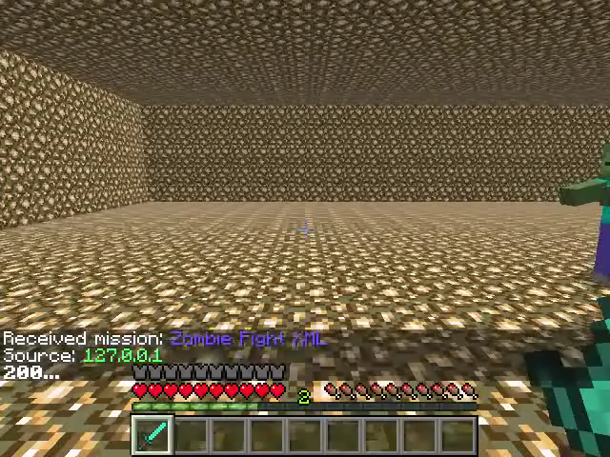
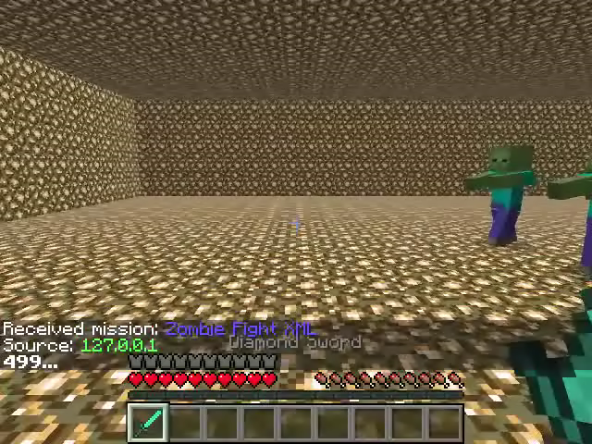
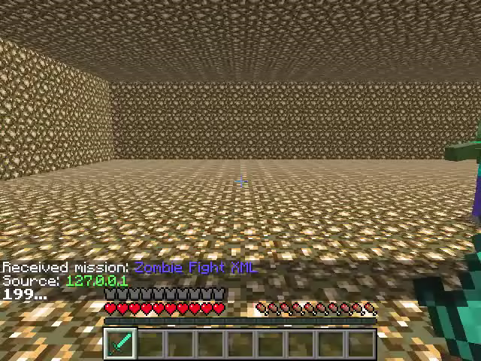
Evaluation
Test Case 1: Fighting 1 zombie
Test Case 1: Fighting 2 zombie
Test Case 1: Fighting 3 zombie
1 kill
2 kills
3 kills
2 kills
1 kill
1 kill

Slide 6
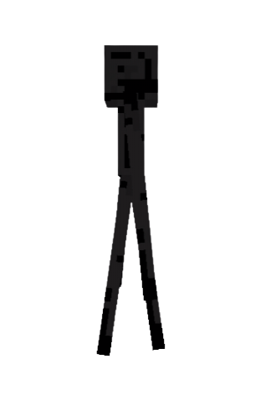

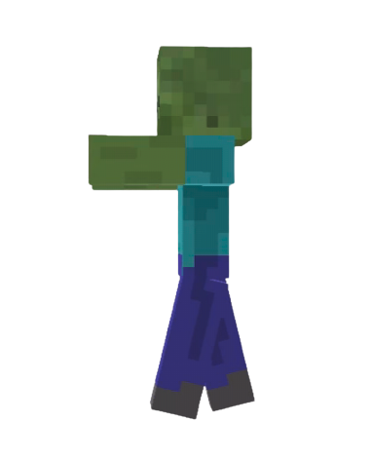
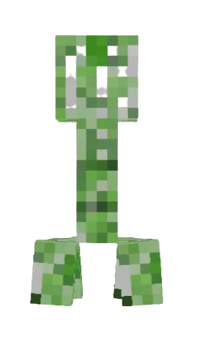
Key Takeaways
Reinforcement Learning in Minecraft
Deep Q-Networks (DQN)
Real-World Applications

Slide 7
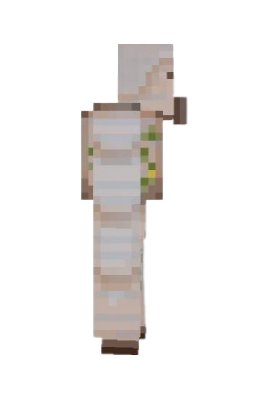
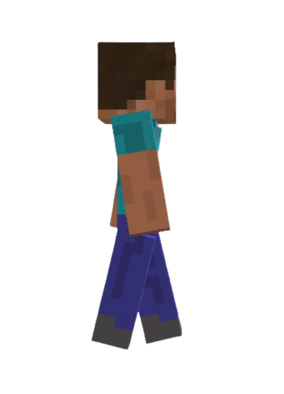


Conclusion and Future Work
Successful implementation of DQN
Promising results in test scenarios
Future work: improvements and extensions
Potential applications

Slide 8
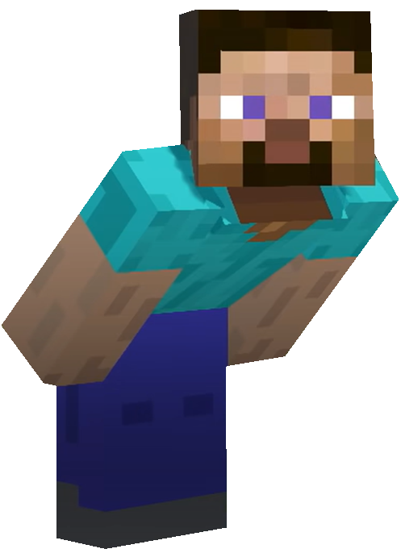
THANKS!

